Slide 1

Navigating Success: MetroCar's Strategic Roadmap
Enhancing User Experience through Data-Driven Insights

Slide 2

Navigating Success: MetroCar's Strategic Roadmap
Objective:
Identifying Opportunities for Enhanced User Engagement and Retention
Approach:
Leveraging Data-Driven Insights to Refine MetroCar's Service Delivery
Notes:
Good day, everyone. Today, I'm excited to share with you the insights from our recent analysis aimed at enhancing user engagement and retention for Metrocar. Our primary objective has been to delve deep into the customer journey, identifying key areas where we can improve and make a real difference in how users interact with our service.
In today's data-driven world, it's essential that we base our strategies on solid, actionable insights. That's exactly what we've done here – leveraging the wealth of data at our disposal to understand our users better.
By analyzing patterns in user behavior, ride utilization, and feedback, we've been able to uncover trends and opportunities that might have otherwise been overlooked.
Understanding our users is not just about looking at numbers. It's about gaining insights into their preferences, their pain points, and their overall experience with Metrocar. This understanding is crucial. It allows us to tailor our services more effectively, ensuring that we're not just meeting but exceeding user expectations.
The findings and recommendations we're about to discuss are more than just observations. They are a roadmap for us to enhance our user engagement and retention strategies. As we go through these insights, I invite you to think about how these can be translated into actionable strategies that will drive Metrocar forward in its journey towards providing an unparalleled user experience.
So, let's dive in and explore how we can unlock new opportunities for Metrocar, ensuring that every user's journey with us is not just satisfactory, but exceptional.

Slide 3

Objectives
Primary Objectives:
Funnel Analysis: Identify stages in the user journey to improve and pinpoint specific drop-off points.
Platform Insights: Analyze user interaction across iOS, Android, and Web platforms to inform marketing strategies.
Age Group Segmentation: Understand performance and preferences of different age groups in the funnel.
Surge Pricing Feasibility: Assess ride request patterns to evaluate the potential for surge pricing.
Secondary Objectives:
Sentiment Analysis: Extract insights from user reviews to enhance service quality.
Cancellation Timing Analysis: Investigate the average time between ride requests and cancellations.
Notes:
Let's start by discussing our primary objectives. These are the core areas we focused on to gain a comprehensive understanding of our user journey and service utilization.
Our first objective was Funnel Analysis. Here, we aimed to dissect each stage of the user journey, identifying where we're losing potential customers and understanding why they might be dropping off.
Next, we delved into Platform Insights. Our goal was to analyze how users interact with Metrocar across different platforms – iOS, Android, and Web. This analysis is crucial for tailoring our marketing strategies to each platform's unique audience.
Understanding our diverse user base led us to our third objective: Age Group Segmentation. By analyzing the performance and preferences of different age groups, we can customize our services to better suit each demographic's needs.
Our final primary objective was assessing the feasibility of Surge Pricing. By examining patterns in ride requests, we aimed to determine the best times to implement surge pricing, balancing profitability with customer satisfaction."
"While our primary objectives form the backbone of our analysis, our secondary objectives provide additional layers of insight."
First in our secondary objectives is Sentiment Analysis. Here, we sifted through user reviews to extract valuable feedback. This analysis helps us understand how our customers perceive our service and where we can improve.
Lastly, we conducted a Cancellation Timing Analysis. By investigating the average time between ride requests and cancellations, we aimed to uncover patterns that might indicate why users cancel and how we can reduce these instances.
Together, these objectives guide our approach to enhancing user experience and operational efficiency. They are the foundation upon which we will build our strategies to elevate Metrocar's service and customer satisfaction.

Slide 4
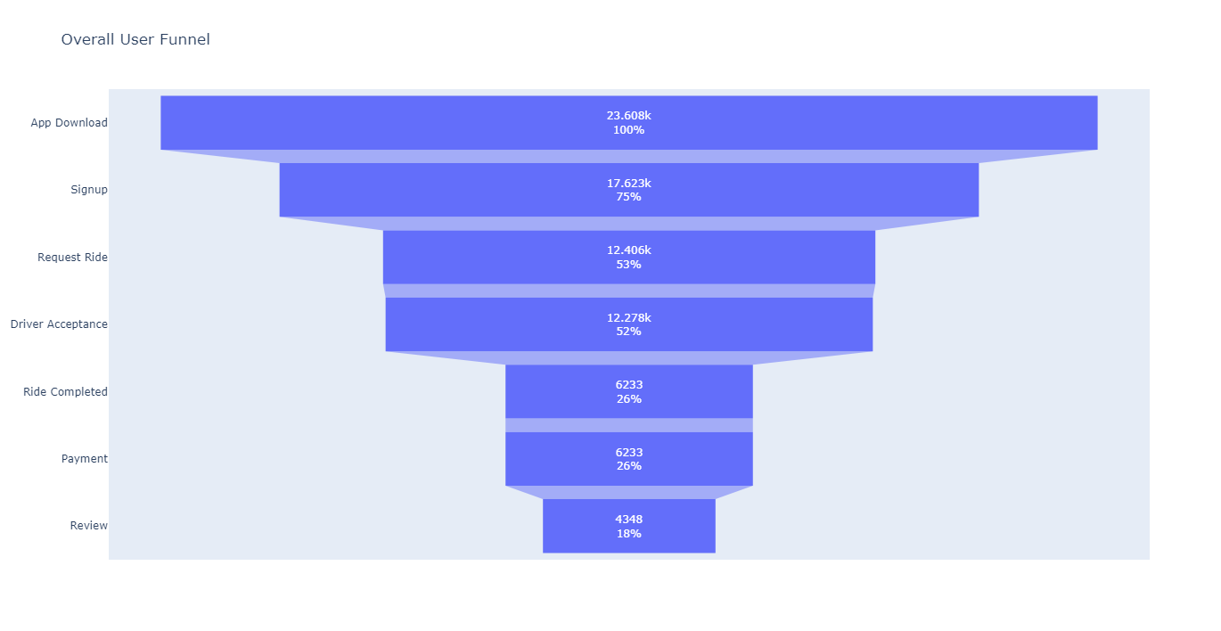
Key Findings: Funnel Analysis & Conversion Optimization
Notes:
"This funnel chart represents the user journey through our Metrocar service. Each stage of the funnel provides us with valuable insights into how users interact with our platform, from downloading the app to completing a ride.
Notice the significant drop-off points, particularly between the Ride Request/Driver Acceptance stage and Ride Completion. This is where we see a substantial decrease in user retention, indicating areas where we need to focus our efforts.
While we have a healthy initial user sign-up rate, only a fraction of these users complete a ride. This discrepancy is a clear indicator that there are underlying issues affecting user retention and satisfaction.
Several factors could contribute to this drop-off. It might be due to wait times, pricing, or even the availability of drivers. Understanding these factors is crucial for us to address these challenges effectively.
These findings are pivotal for our strategy moving forward. They highlight the need for targeted interventions to improve user experience and ensure that more users complete their journey from downloading the app to successfully completing a ride.
In the upcoming slides, we'll discuss specific recommendations based on these insights. Our goal is to optimize each stage of the funnel, enhancing user satisfaction and boosting overall service efficiency.

Slide 5
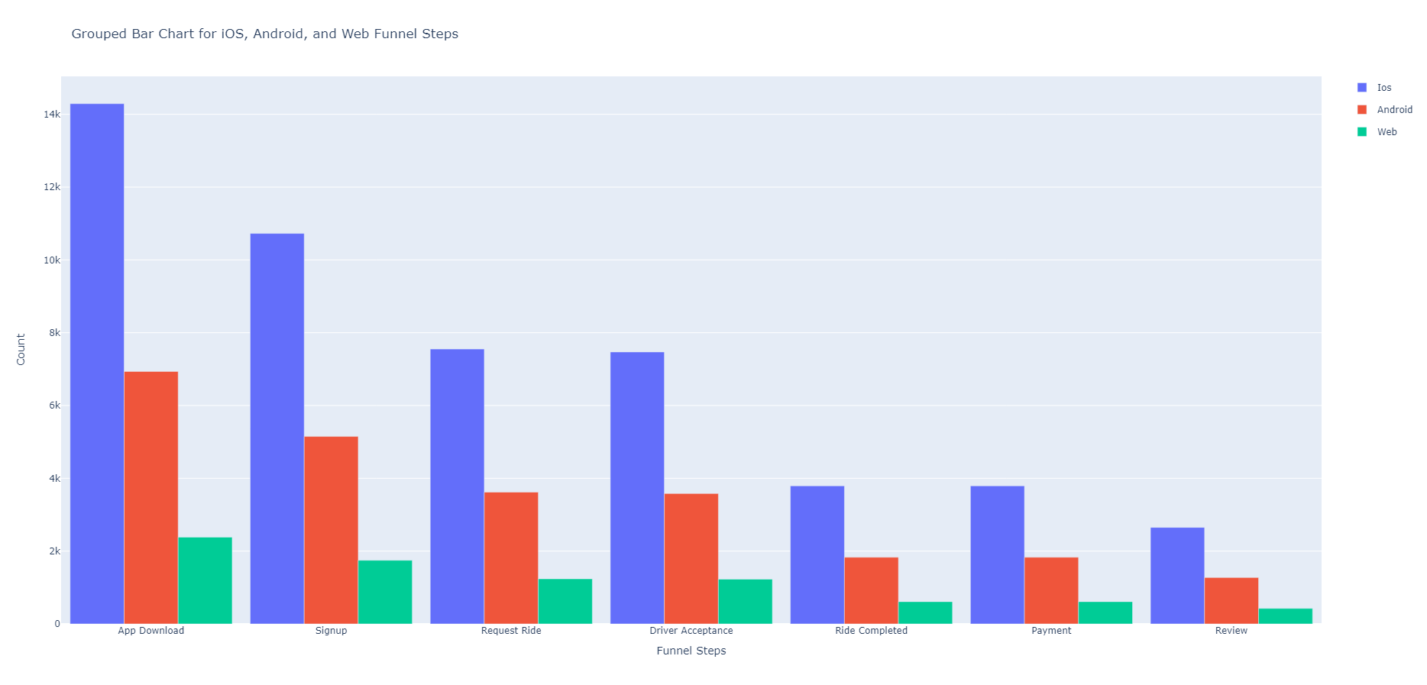
Key Findings: Platform Analysis
Notes:
This section of our analysis focuses on the distribution of Metrocar users across various platforms: iOS, Android, and Web. Understanding this distribution is crucial for tailoring our marketing and development efforts.
Our data shows a clear preference for the iOS platform among Metrocar users, with a significant majority using iOS devices. This aligns with the general market trends, especially in the US, where iOS holds a substantial market share
It's interesting to note that the iOS platform is particularly popular among Millennials and Gen Z users. This demographic information is vital for targeted marketing and ensuring that our app's features resonate with our primary user base
While iOS leads in user numbers, Android also has a considerable user base. This diversity in platform usage underscores the importance of maintaining a cross-platform approach to app development and marketing.
Given the dominance of iOS in our user base, it makes sense to prioritize iOS in our marketing campaigns. However, we should not neglect Android and Web users, as they represent significant segments of our market. As Metrocar looks to expand, it's important to note that while iOS dominance is strong in the US and Canada, globally Android holds about 70% of the market share. This global perspective is crucial for our international expansion plans, where a more Android-centric approach may be necessary to effectively reach and engage with a broader audience.
In our recommendations, we will explore how we can leverage these insights to develop platform-specific strategies. This includes optimizing our app's performance and user experience on each platform and tailoring our marketing messages to resonate with the users of each platform.

Slide 6
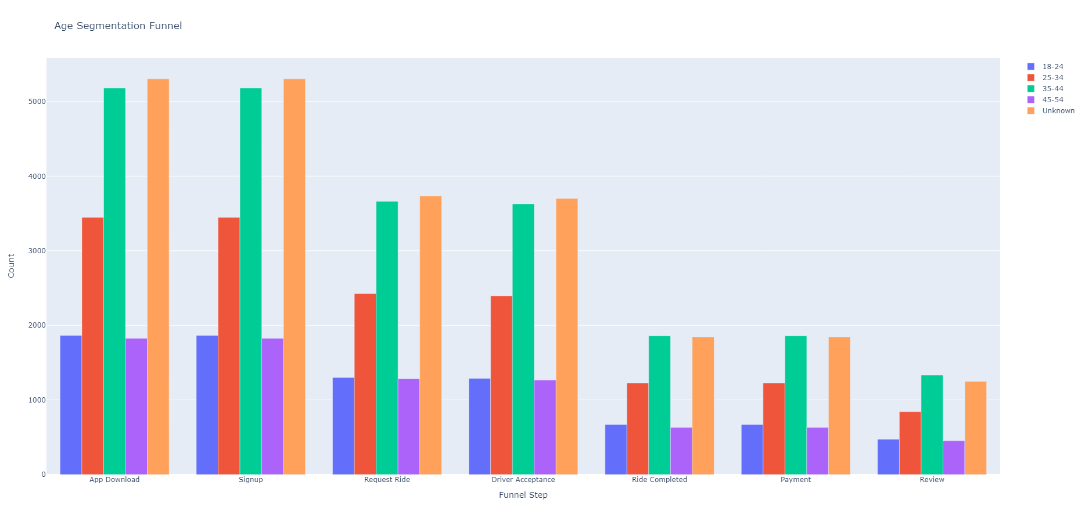
Key Findings: Age Group Analysis
Notes:
In our analysis of age group segmentation, we found that the 35-44 age group has the highest ride completion rate, followed by the 25-34 and 18-24 age groups. This suggests that Metrocar is primarily used for work commutes by the working-age population. A notable finding is the significant number of users in the 'Unknown' age category, which highlights a potential gap in our data collection. Addressing this gap presents an opportunity to refine our data collection methods and enhance our marketing strategies. By focusing on the most active age groups, we aim to boost user engagement and ride completion rates. Moreover, engaging with the 'Unknown' category could open up new market segments, contributing to Metrocar's growth. It's also important to note that age does not seem to be a major factor in ride completion, as there is minimal difference in funnel drop-off rates across different age groups. This insight can inform our approach to user retention and service optimization.

Slide 7
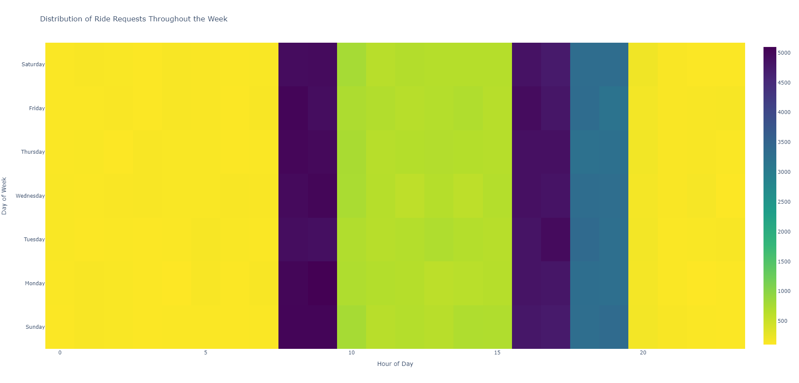
Key Findings: Surge Pricing Feasibility
Notes:
In our analysis of surge pricing feasibility, we observed consistent peak times in ride requests, particularly between 8 AM - 10 AM and 4 PM - 8 PM daily. As this chart shows, it is every day of the week, not just weekdays. These patterns suggest a strong opportunity for implementing surge pricing during these high-demand periods. By doing so, Metrocar can optimize revenue and better manage demand.
However, it's crucial to approach surge pricing with caution. While it can increase revenue during peak times, it also has the potential to impact customer satisfaction negatively. Customers may be sensitive to price increases, and significant spikes could lead to a decrease in ride requests. Therefore, if Metrocar decides to implement surge pricing, it should be accompanied by careful monitoring of customer feedback and ride request patterns. This will allow us to adjust our strategy as needed to maintain a balance between revenue optimization and customer satisfaction.
Furthermore, introducing surge pricing could incentivize more drivers to be available during peak hours, potentially reducing wait times and improving service availability. This could enhance the overall customer experience, offsetting any negative perceptions of increased pricing.
In summary, while surge pricing presents a promising opportunity for revenue growth, it must be implemented thoughtfully, with continuous monitoring and adjustments based on customer feedback and market dynamics.

Slide 8
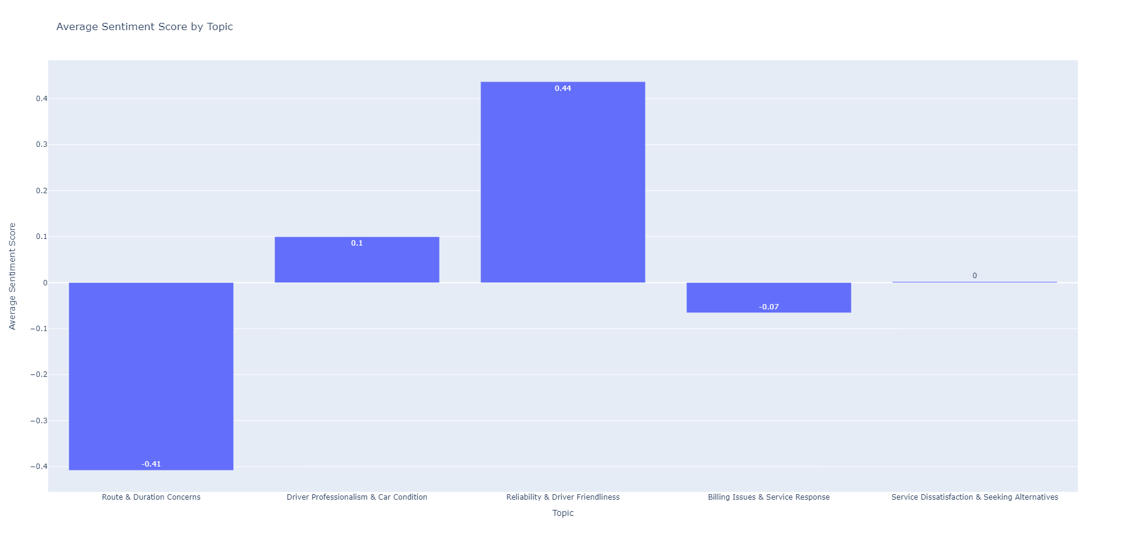
Key Findings: Sentiment Analysis
Notes:
While a Sentiment Analysis was not a part of the original scope of the project, it serves as enrichment to the funnel analysis and provides a jumping off point for a deeper understanding of Metrocar’s customer needs.
Our sentiment analysis of customer reviews revealed a balanced yet concerning distribution of opinions. Approximately 45.9% of reviews were positive, while 44.6% were negative. This split suggests that while many customers are satisfied, a significant portion has issues with our service.
The analysis pinpointed several critical areas where customers expressed dissatisfaction. These include Route & Duration Concerns, Driver Professionalism, and Billing Issues. Understanding these pain points is crucial for identifying where our service may be falling short. The presence of substantial negative feedback is a clear indicator that there are aspects of our service that need improvement. Negative experiences can have a lasting impact on customer loyalty and our brand's reputation.
The mixed nature of the reviews highlights the diversity of customer experiences with our service. It underscores the need for a nuanced approach to addressing these issues, as different customers may have varying expectations and experiences. The sentiment analysis provides valuable insights into what customers value and where they feel we could do better. These insights are critical for guiding our efforts to enhance service quality and customer satisfaction.
Moving forward, it's essential to delve deeper into these areas of concern, understand the underlying causes, and develop targeted strategies to address them. This will be a key focus in our recommendations to improve customer experience and satisfaction.

Slide 9
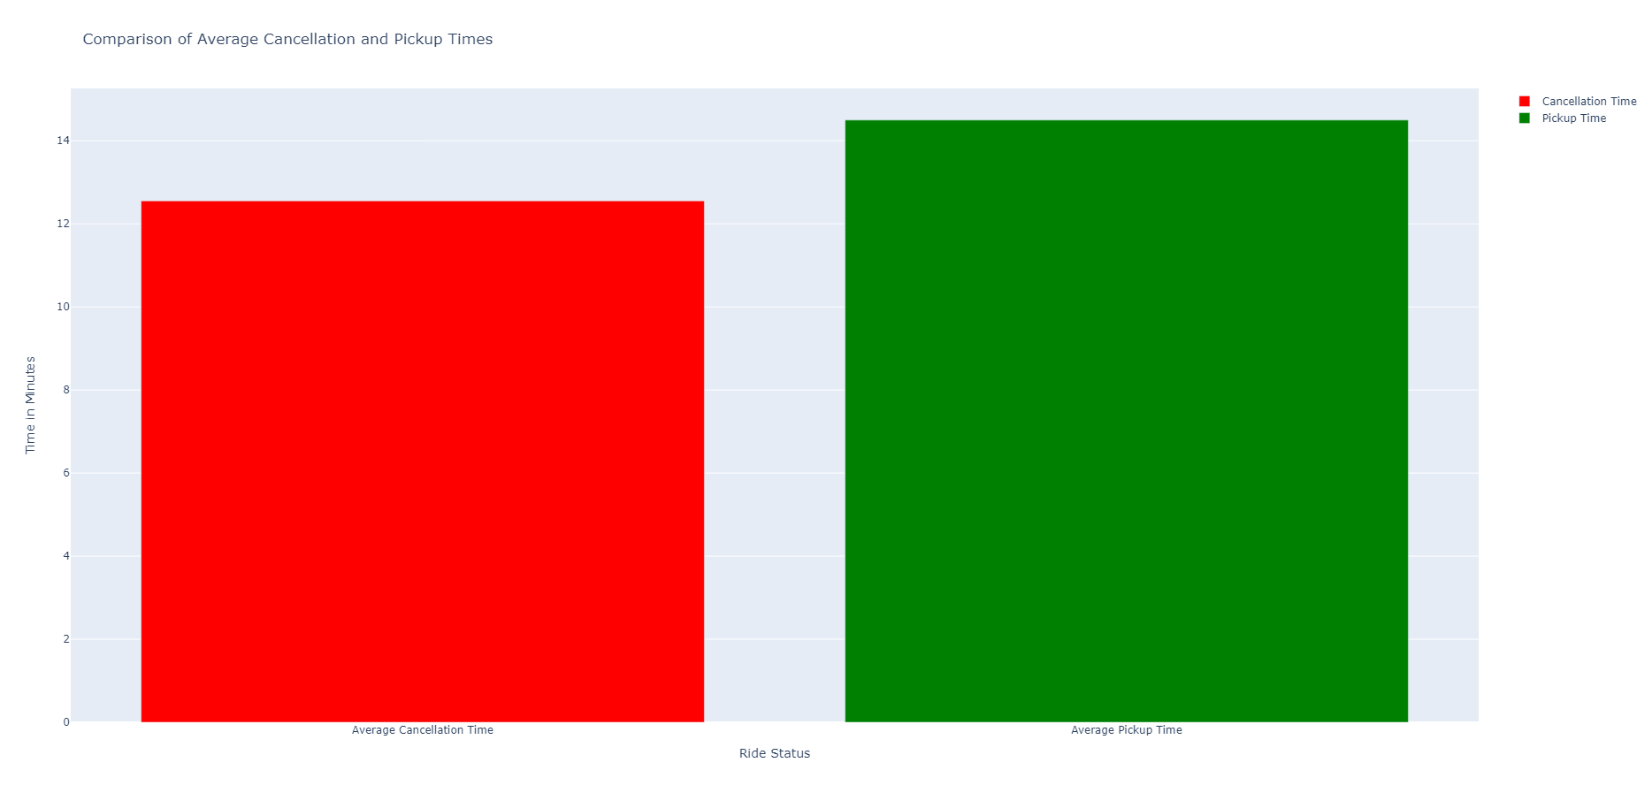
Key Findings: Cancellation Timing Analysis
Notes:
Going slightly outside of the scope of the project again, we took a look at the average time a user waited to cancel or to be picked up. This was to help understand if there is a correlation between this wait time and the major drop off between Requesting and Completing a ride.
With the average time to pickup being 14m29s and average time to cancel being 12m33s there appears to be other factors contributing to users canceling their ride request. There is a strong need to research this further as only 50% of users who request a ride complete the ride and only 26% of users who downloaded the app complete a ride! There is a great opportunity among Metrocar’s existing userbase to grow revenue.
The insights from the key findings will inform the recommendations for improving user retention and satisfaction, which we will now review.

Slide 10

Strategic Recommendations for Metrocar: Optimizing the User Journey
Conduct in-depth research to understand the drop-off from ride request to completion.
Implement feedback mechanisms for users who cancel rides.
Explore strategies to increase ride completion rates from existing user base.
Notes:
With a large userbase, Metrocar has a significant opportunity to increase revenue by converting more app users into paying customers. Currently, a staggering 74% of users who download the app do not complete a ride, representing a substantial untapped market. To address this, it's crucial to delve into the reasons behind this high drop-off rate.
One effective approach is to conduct user surveys and focus groups. These tools can provide deep insights into user preferences, expectations, and pain points. By engaging directly with users, we can uncover specific factors that discourage them from completing a ride. This might include issues related to app usability, service quality, pricing, or other concerns that are not immediately apparent.
In addition to these research methods, implementing a feedback mechanism for cancelled rides is another strategic move. This can be integrated directly into the app, prompting users to share their reasons for cancellation immediately after they cancel a ride. Such real-time feedback is invaluable, as it captures the user's sentiment and reasoning at the moment of cancellation, providing more accurate and actionable data.
Furthermore, analyzing this feedback can help us identify patterns and common themes in user cancellations. Are there specific times, locations, or circumstances that lead to higher cancellation rates? Is there a correlation between the wait time for a ride and the likelihood of cancellation? Understanding these nuances can guide us in refining our service offerings, making the app more user-friendly, and tailoring our marketing strategies to address the needs and preferences of our user base.
Ultimately, the goal is to reduce the gap between app downloads and ride completions. By gaining a clearer understanding of our users' journey from app download to ride completion, we can implement targeted improvements that not only enhance user satisfaction but also drive higher conversion rates, leading to increased revenue and market share for Metrocar.

Slide 11
Strategic Recommendations for Metrocar: Optimize Marketing Efforts
Intensify marketing efforts on the iOS platform, targeting the 25-44 age group.
Develop strategies to engage users in other platforms and age groups.
Improve data collection methods to reduce the number of users in the 'Unknown' age category.
Notes:
Given the significant user base on the iOS platform, it's imperative to intensify marketing efforts targeting this segment. Specifically, focusing on the 25-44 age group, which shows the highest ride completion rates, can yield substantial returns. This could involve tailored advertising campaigns, personalized promotions, and exclusive offers that resonate with the lifestyle and preferences of this demographic. By leveraging the data-driven insights we've gathered, these campaigns can be highly targeted and effective. While iOS users represent a major segment, it's crucial not to overlook the potential of Android and Web users. Developing unique engagement strategies for these platforms can help tap into new customer segments. This might include platform-specific features, incentives, or marketing messages that appeal to the unique characteristics and preferences of users on these platforms. Similarly, creating targeted campaigns for other age groups, especially those with lower ride completion rates, can help in increasing their engagement and conversion. A significant number of users fall into the 'Unknown' age category, indicating a gap in our data collection methods. Improving these methods is essential for gaining a more comprehensive understanding of our user base. This could involve revising the app's onboarding process to encourage users to provide their age information, or using indirect methods like data modeling to infer age groups. Better data collection will not only provide more accurate insights for targeted marketing but also help in customizing the user experience, leading to higher satisfaction and retention rates.
By implementing these strategic recommendations, Metrocar can optimize its marketing efforts, leading to increased user engagement, higher conversion rates, and ultimately, greater market share and revenue."

Slide 12
Strategic Recommendations for Metrocar: Implementing Effective Surge Pricing
Introduce surge pricing during peak hours (8-10 AM and 4-8 PM).
Monitor customer feedback closely to assess the impact of surge pricing.
Adjust surge pricing strategies based on user response and demand patterns.
Notes:
Our data analysis has identified consistent peak demand periods, particularly between 8-10 AM and 4-8 PM daily. Implementing surge pricing during these hours can optimize revenue and manage demand more effectively. This strategy should be communicated clearly to both customers and drivers, highlighting the benefits such as increased driver availability and efficient service during high-demand periods.
The introduction of surge pricing can significantly impact customer perception and satisfaction. It's crucial to establish a robust system for monitoring customer feedback in real-time. This could involve surveys, app-based feedback mechanisms, and social media monitoring. The goal is to gauge customer reactions to surge pricing and identify any negative trends or concerns that may arise.
Surge pricing should not be a static model but rather a dynamic one that adapts to changing user responses and demand patterns. Regular analysis of ride request data, customer feedback, and market conditions should inform adjustments to the surge pricing model. This might include tweaking the pricing algorithm, modifying peak hours, or even offering promotional discounts during off-peak times to maintain customer loyalty and satisfaction. To mitigate any potential backlash, it's important to educate users about the reasons behind surge pricing and its benefits. This could involve informational campaigns through the app, email newsletters, and social media, explaining how surge pricing helps ensure availability and quick service during busy times.

Slide 13

Strategic Recommendations for Metrocar: Enhancing Customer Satisfaction
Address key areas of concern identified in sentiment analysis (e.g., Route Concerns, Billing Issues).
Enhance driver training and improve routing algorithms.
Ensure transparent billing practices to improve customer trust and satisfaction.
Notes:
As the Sentiment Analysis was not initially included in the project's scope, our exploration into this area was preliminary. However, even this initial foray has yielded valuable insights, highlighting the need for a more in-depth analysis to fully understand our customers' perceptions and experiences with Metrocar.
Key areas of concern have already surfaced from this preliminary analysis, notably around Routing and Trip Duration, Driver Professionalism, and Billing Issues. These areas are critical touchpoints in the customer journey and significantly influence overall satisfaction
Customers have expressed concerns regarding the efficiency and accuracy of the routes taken during their rides. There's a need to delve deeper into these concerns to understand if these issues are due to technical limitations, geographical challenges, or other factors. Improving our routing algorithms and ensuring more accurate estimated times of arrival could greatly enhance customer satisfaction.
Feedback regarding driver conduct and professionalism has been mixed. This area is crucial as drivers are the face of Metrocar and directly interact with our customers. A more detailed analysis will help us understand specific issues and develop targeted training programs for drivers, ensuring consistent service quality and professionalism.
Billing transparency and accuracy have been highlighted as areas of concern. Customers value straightforward and fair billing practices. A deeper analysis will allow us to identify the root causes of these issues, whether they stem from technical glitches, policy gaps, or communication breakdowns, and address them effectively.
By investing more time and resources into a comprehensive Sentiment Analysis, we can gain a clearer understanding of these and other issues. This will enable us to take targeted actions to address customer concerns, improve their experience, and build stronger, more loyal relationships with our user base.

Slide 14
Questions and Discussion

Slide 15
Thank You

